Slide 1
In-Context Learning with Hypothesis Class Guidance (ICL-HCG)
Ziqian Lin, Shubham Kumar Bharti, Kangwook Lee

Slide 2
Background: LLM&ICL
example

Slide 3
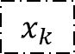
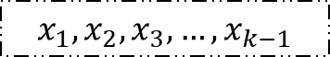
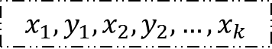
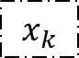
Background: Synthetic Data
$$x_{k}$$
Transformer
Type 1: Unaligned Sequence (?)
$$x_{1},x_{2},x_{3},…,x_{k−1}$$
distinguished by training sequences
$$x_{k}$$
Type 2: Aligned Sequence
(?)
Transformer
$$x_{1},y_{1},x_{2},y_{2},…,x_{k}$$

Slide 4
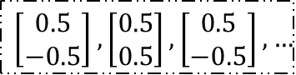
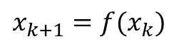
Background: Synthetic Data
$$x_{k}$$
1,0,2,2,1,2,…
0
1
2
Transformer
or
Type 1: Unaligned Sequence
$$\left[\begin{matrix}0.5 \\ −0.5\end{matrix}\right],\left[\begin{matrix}0.5 \\ 0.5\end{matrix}\right],\left[\begin{matrix}0.5 \\ −0.5\end{matrix}\right],…$$
$$x_{k+1}=f(x_{k})$$
$$x_{1},x_{2},x_{3},…,x_{k−1}$$
distinguished by training sequences
$$x_{k}$$
Type 2: Aligned Sequence
Transformer
$$x_{1},y_{1},x_{2},y_{2},…,x_{k}$$

Slide 5
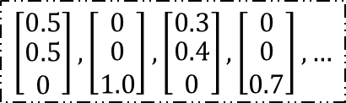
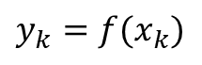
Background: Synthetic Data
$$x_{k}$$
1,0,2,2,1,2,…
0
1
2
Transformer
or
Type 1: Unaligned Sequence
$$\left[\begin{matrix}0.5 \\ −0.5\end{matrix}\right],\left[\begin{matrix}0.5 \\ 0.5\end{matrix}\right],\left[\begin{matrix}0.5 \\ −0.5\end{matrix}\right],…$$
$$x_{k+1}=f(x_{k})$$
$$x_{1},x_{2},x_{3},…,x_{k−1}$$
distinguished by training sequences
$$x_{k}$$
Type 2: Aligned Sequence
Transformer
$$\left[\begin{matrix}0.5 \\ \begin{aligned}0.5 \\ 0\end{aligned}\end{matrix}\right],\left[\begin{matrix}0 \\ \begin{aligned}0 \\ 1.0\end{aligned}\end{matrix}\right],\left[\begin{matrix}0.3 \\ \begin{aligned}0.4 \\ 0\end{aligned}\end{matrix}\right],\left[\begin{matrix}0 \\ \begin{aligned}0 \\ 0.7\end{aligned}\end{matrix}\right],…$$
$$y_{k}=f(x_{k})$$
$$x_{1},y_{1},x_{2},y_{2},…,x_{k}$$

Slide 6
Background: Unaligned Sequence
1st work: An Explanation of In-context Learning as Implicit Bayesian Inference
unaligned
Generate training sequence
/
1
2
1,2,2,2,/,1,2,/,1,/,2,2,2,2,/,1,1,…
aligned
Generate testing ICL sequence
/
1
2
1,2,/,1,2,/,2,2,/,1,2,/,2,[?]

Slide 7
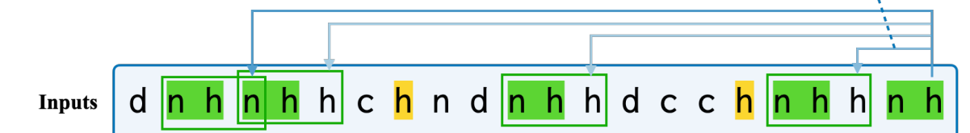
Background: Unaligned Sequence
1st work: An Explanation of In-context Learning as Implicit Bayesian Inference
Induction head: In-Context Language Learning: Architectures and Algorithms
Explain such copy-paste ability through attention map

Slide 8
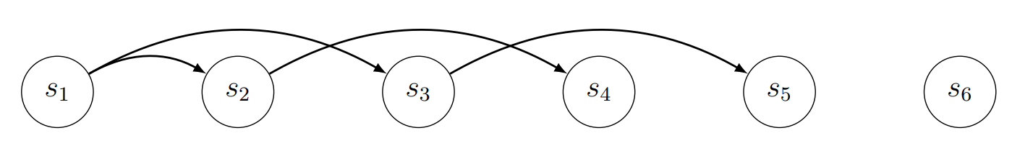
Background: Unaligned Sequence
1st work: An Explanation of In-context Learning as Implicit Bayesian Inference
Induction head: In-Context Language Learning: Architectures and Algorithms
Causal: How Transformers Learn Causal Structure with Gradient Descent

Slide 9
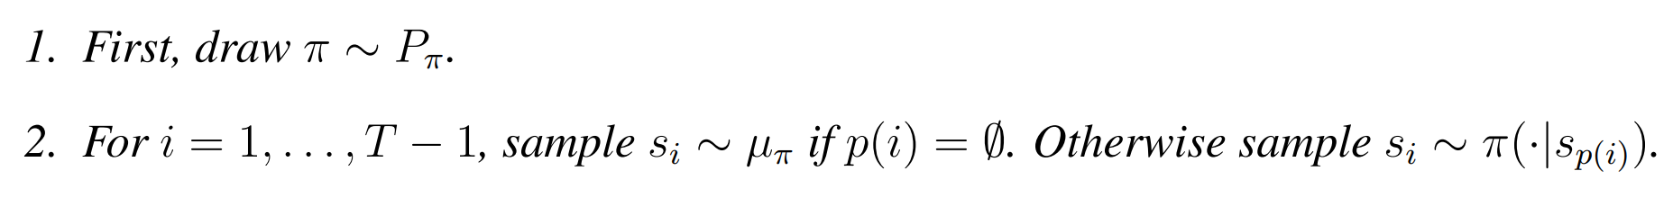
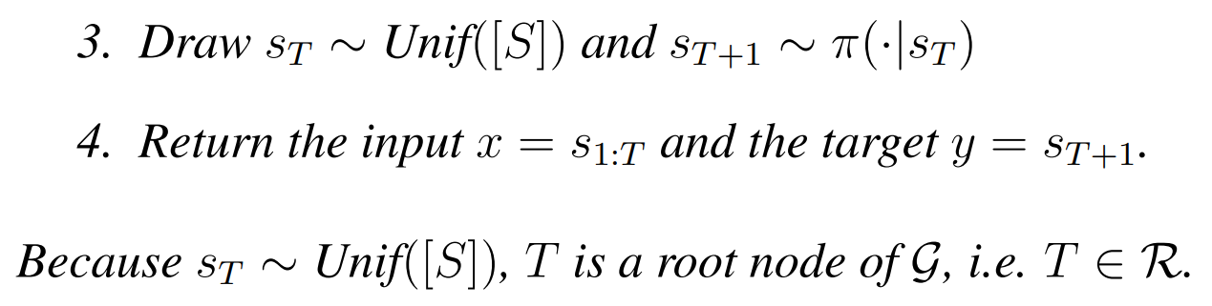
Background: Unaligned Sequence
1st work: An Explanation of In-context Learning as Implicit Bayesian Inference
Induction head: In-Context Language Learning: Architectures and Algorithms
Causal: How Transformers Learn Causal Structure with Gradient Descent

Slide 10
Background: Unaligned Sequence
1st work: An Explanation of In-context Learning as Implicit Bayesian Inference
Induction head: In-Context Language Learning: Architectures and Algorithms
Causal: How Transformers Learn Causal Structure with Gradient Descent
…

Slide 11
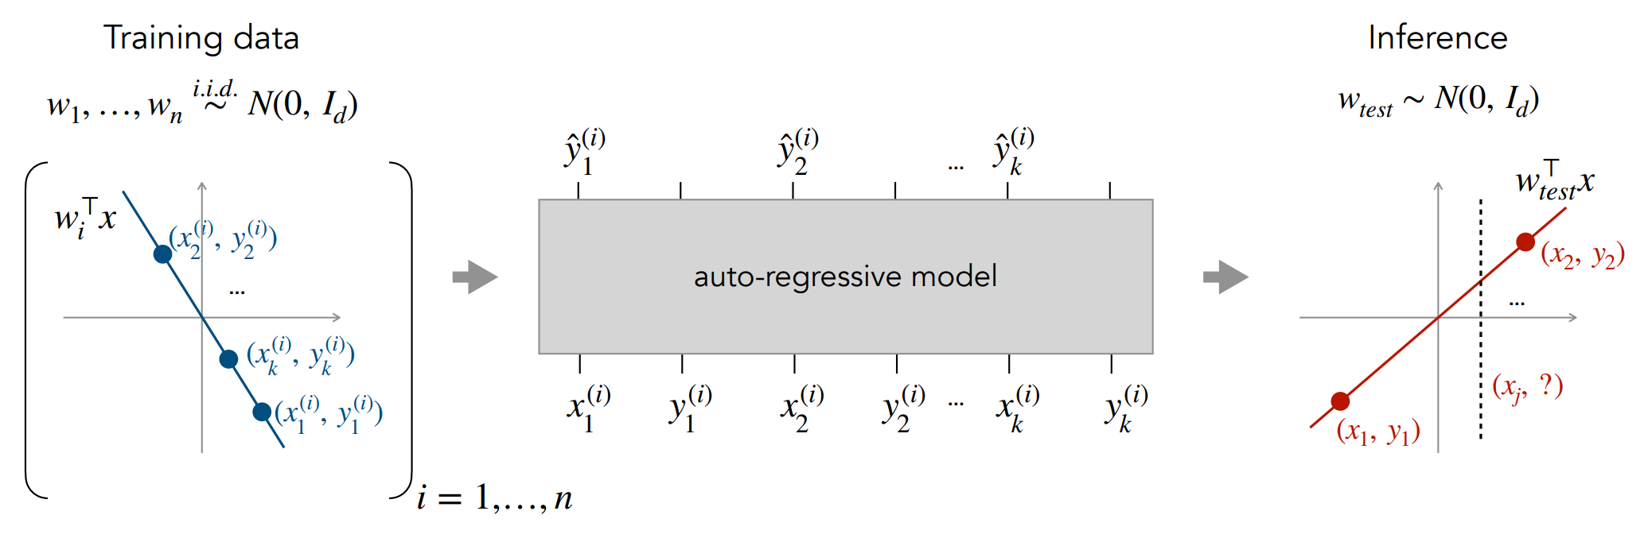
Background: Aligned Sequence
1st work: What Can Transformers Learn In-Context? A Case Study of Simple Function Classes

Slide 12
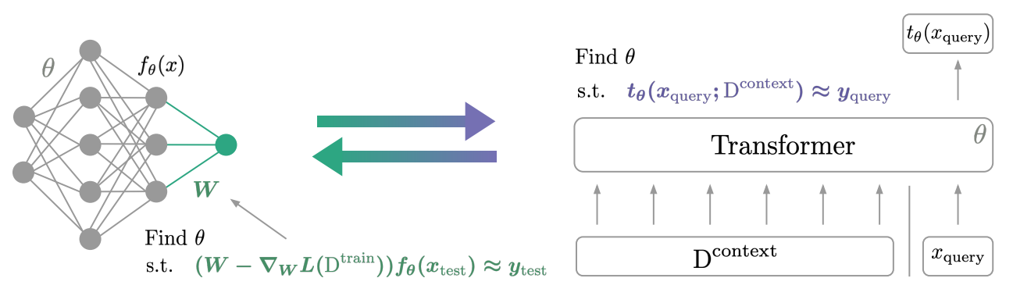
Background: Aligned Sequence
1st work: What Can Transformers Learn In-Context? A Case Study of Simple Function Classes
Gradient descent: Transformers Learn In-Context by Gradient Descent

Slide 13
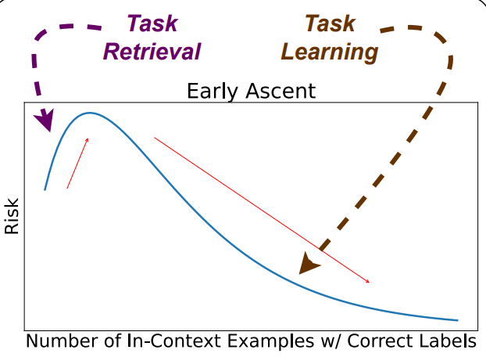
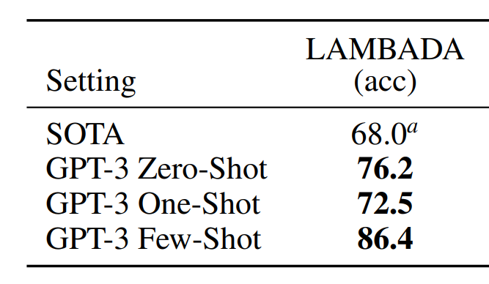
Background: Aligned Sequence
1st work: What Can Transformers Learn In-Context? A Case Study of Simple Function Classes
Gradient descent: Transformers Learn In-Context by Gradient Descent
Task Retrieval & Learning: Dual Operating Modes of In-Context Learning
syntheitc
Real-world

Slide 14
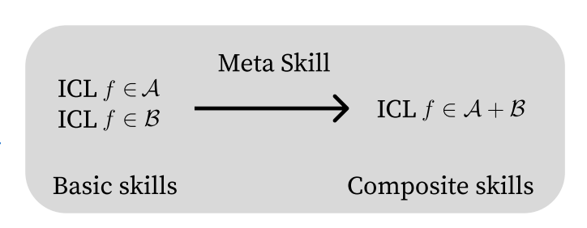
Background: Aligned Sequence
1st work: What Can Transformers Learn In-Context? A Case Study of Simple Function Classes
Gradient descent: Transformers Learn In-Context by Gradient Descent
Task Retrieval & Learning: Dual Operating Modes of In-Context Learning
Task Mixture: Transformers Can Learn Meta-skills for Task Generalization in In-Context Learning

Slide 15
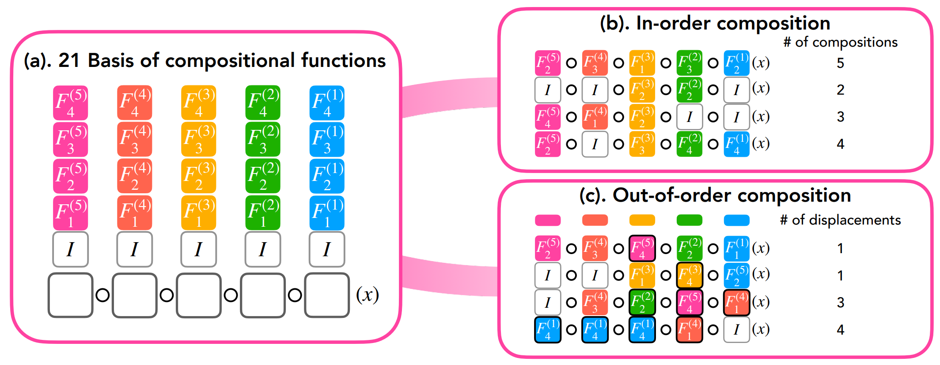
Background: Aligned Sequence
1st work: What Can Transformers Learn In-Context? A Case Study of Simple Function Classes
Gradient descent: Transformers Learn In-Context by Gradient Descent
Task Retrieval & Learning: Dual Operating Modes of In-Context Learning
Task Mixture: Transformers Can Learn Meta-skills for Task Generalization in In-Context Learning
Task Composition*: Compositional Capabilities of Autoregressive Transformers: A Study on Synthetic, Interpretable Tasks
* means there is no multiple xy pairs in the study

Slide 16
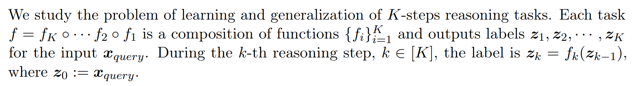
Background: Aligned Sequence
1st work: What Can Transformers Learn In-Context? A Case Study of Simple Function Classes
Gradient descent: Transformers Learn In-Context by Gradient Descent
Task Retrieval & Learning: Dual Operating Modes of In-Context Learning
Task Mixture: Transformers Can Learn Meta-skills for Task Generalization in In-Context Learning
Task Composition*: Compositional Capabilities of Autoregressive Transformers: A Study on Synthetic, Interpretable Tasks
CoT: How Do Nonlinear Transformers Acquire Generalization-Guaranteed CoT Ability?
* means there is no multiple xy pairs in the study

Slide 17
Background: Aligned Sequence
1st work: What Can Transformers Learn In-Context? A Case Study of Simple Function Classes
Gradient descent: Transformers Learn In-Context by Gradient Descent
Task Retrieval & Learning: Dual Operating Modes of In-Context Learning
Task Mixture: Transformers Can Learn Meta-skills for Task Generalization in In-Context Learning
Task Composition: Compositional Capabilities of Autoregressive Transformers: A Study on Synthetic, Interpretable Tasks
CoT: How Do Nonlinear Transformers Acquire Generalization-Guaranteed CoT Ability?
…

Slide 18
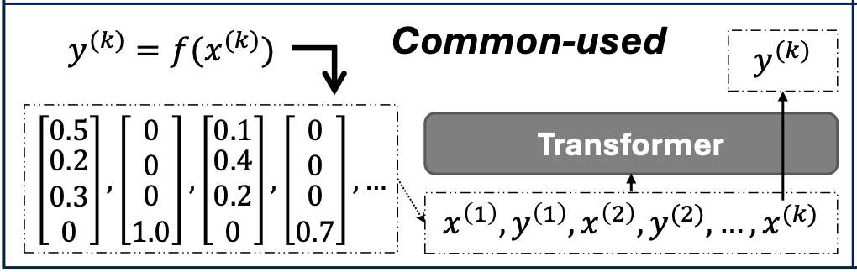
Background: Aligned Sequence
1st work: What Can Transformers Learn In-Context? A Case Study of Simple Function Classes
Gradient descent: Transformers Learn In-Context by Gradient Descent
Task Retrieval & Learning: Dual Operating Modes of In-Context Learning
Task Mixture: Transformers Can Learn Meta-skills for Task Generalization in In-Context Learning
Task Composition: Compositional Capabilities of Autoregressive Transformers: A Study on Synthetic, Interpretable Tasks
CoT: How Do Nonlinear Transformers Acquire Generalization-Guaranteed CoT Ability?
…

Slide 19
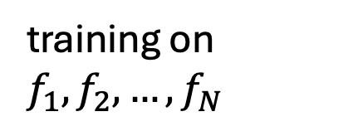
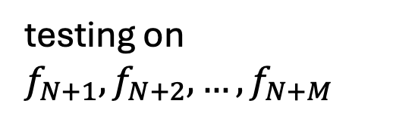
Background: Aligned Sequence
1st work: What Can Transformers Learn In-Context? A Case Study of Simple Function Classes
Gradient descent: Transformers Learn In-Context by Gradient Descent
Task Retrieval & Learning: Dual Operating Modes of In-Context Learning
Task Mixture: Transformers Can Learn Meta-skills for Task Generalization in In-Context Learning
Task Composition: Compositional Capabilities of Autoregressive Transformers: A Study on Synthetic, Interpretable Tasks
CoT: How Do Nonlinear Transformers Acquire Generalization-Guaranteed CoT Ability?
…
training on $f_{1},f_{2},…,f_{N}$
testing on $f_{N+1}, f_{N+2}, …,f_{N+M}$

Slide 20
Background: The Meaning of Synthetic Dataset
Though easy => playgrounds => deeper study
Gradient descent
Task Retrieval & Learning
Task Mixture
Task Composition
CoT
…

Slide 21
Motivation: The Overlook on Instruction
instruction

Slide 22
Motivation: The Overlook on Instruction

Slide 23
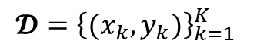
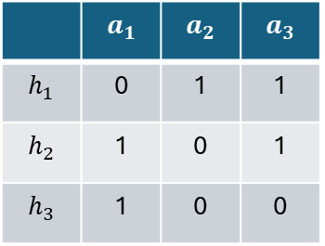
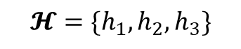
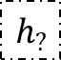
Our Framework
$$𝓗=\{h_{1},h_{2},h_{3}\}$$
$$h_{?}$$
 | $$a_{1}$$ | $$a_{2}$$ | $$a_{3}$$
$$h_{1}$$ | 0 | 1 | 1
$$h_{2}$$ | 1 | 0 | 1
$$h_{3}$$ | 1 | 0 | 0
This work
$$𝓓={\left\{(x_{k},y_{k})\right\}}_{k=1}^{K}$$

Slide 24
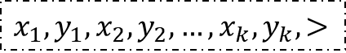
Our Framework
$$𝓗=\{h_{1},h_{2},h_{3}\}$$
$$h_{?}$$
 | $$a_{1}$$ | $$a_{2}$$ | $$a_{3}$$
$$h_{1}$$ | 0 | 1 | 1
$$h_{2}$$ | 1 | 0 | 1
$$h_{3}$$ | 1 | 0 | 0
Transformer
This work
hypothesis prefix
$$x_{1},y_{1},x_{2},y_{2},…,x_{k},y_{k},>$$
$$𝓓={\left\{(x_{k},y_{k})\right\}}_{k=1}^{K}$$

Slide 25
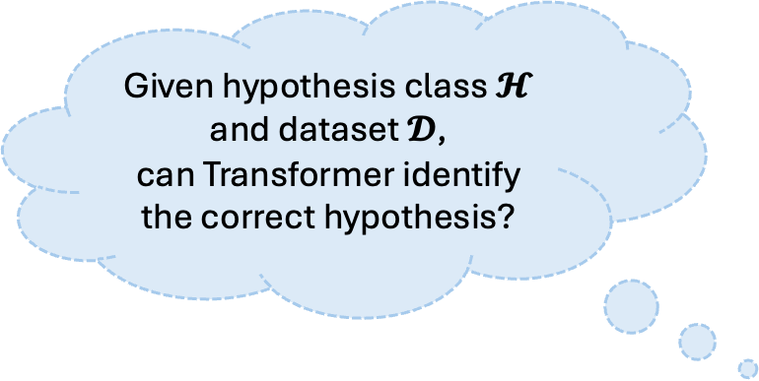
Our Framework
Given hypothesis class $𝓗$
and dataset $𝓓$,
can Transformer identify the correct hypothesis?
$$𝓗=\{h_{1},h_{2},h_{3}\}$$
$$h_{?}$$
 | $$a_{1}$$ | $$a_{2}$$ | $$a_{3}$$
$$h_{1}$$ | 0 | 1 | 1
$$h_{2}$$ | 1 | 0 | 1
$$h_{3}$$ | 1 | 0 | 0
Transformer
This work
hypothesis prefix
$$x_{1},y_{1},x_{2},y_{2},…,x_{k},y_{k},>$$
$$𝓓={\left\{(x_{k},y_{k})\right\}}_{k=1}^{K}$$
D large enough

Slide 26
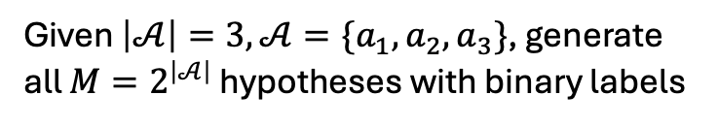
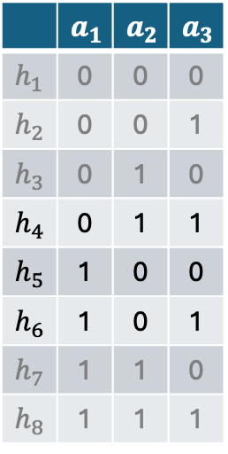
Our Framework
Given $\left|𝒜\right|=3, 𝒜=\{a_{1},a_{2},a_{3}\}$, generate all $M=2^{\left|𝒜\right|}$ hypotheses with binary labels
 | $$a_{1}$$ | $$a_{2}$$ | $$a_{3}$$
$$h_{1}$$ | 0 | 0 | 0
$$h_{2}$$ | 0 | 0 | 1
$$h_{3}$$ | 0 | 1 | 0
$$h_{4}$$ | 0 | 1 | 1
$$h_{5}$$ | 1 | 0 | 0
$$h_{6}$$ | 1 | 0 | 1
$$h_{7}$$ | 1 | 1 | 0
$$h_{8}$$ | 1 | 1 | 1

Slide 27
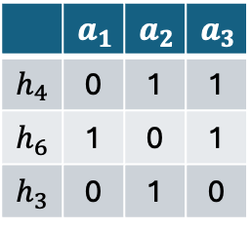
Our Framework
Given $\left|𝒜\right|=3, 𝒜=\{a_{1},a_{2},a_{3}\}$, generate all $M=2^{\left|𝒜\right|}$ hypotheses with binary labels
 | $$a_{1}$$ | $$a_{2}$$ | $$a_{3}$$
$$h_{1}$$ | 0 | 0 | 0
$$h_{2}$$ | 0 | 0 | 1
$$h_{3}$$ | 0 | 1 | 0
$$h_{4}$$ | 0 | 1 | 1
$$h_{5}$$ | 1 | 0 | 0
$$h_{6}$$ | 1 | 0 | 1
$$h_{7}$$ | 1 | 1 | 0
$$h_{8}$$ | 1 | 1 | 1
hypothesis class
Sample m=3 hypotheses
 | $$a_{1}$$ | $$a_{2}$$ | $$a_{3}$$
$$h_{4}$$ | 0 | 1 | 1
$$h_{6}$$ | 1 | 0 | 1
$$h_{3}$$ | 0 | 1 | 0
hypothesis table

Slide 28
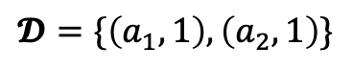
Our Framework
Given $\left|𝒜\right|=3, 𝒜=\{a_{1},a_{2},a_{3}\}$, generate all $M=2^{\left|𝒜\right|}$ hypotheses with binary labels
 | $$a_{1}$$ | $$a_{2}$$ | $$a_{3}$$
$$h_{1}$$ | 0 | 0 | 0
$$h_{2}$$ | 0 | 0 | 1
$$h_{3}$$ | 0 | 1 | 0
$$h_{4}$$ | 0 | 1 | 1
$$h_{5}$$ | 1 | 0 | 0
$$h_{6}$$ | 1 | 0 | 1
$$h_{7}$$ | 1 | 1 | 0
$$h_{8}$$ | 1 | 1 | 1
hypothesis class
Sample m=3 hypotheses
 | $$a_{1}$$ | $$a_{2}$$ | $$a_{3}$$
$$h_{4}$$ | 0 | 1 | 1
$$h_{6}$$ | 1 | 0 | 1
$$h_{3}$$ | 0 | 1 | 0
$$𝓓=\{\left(a_{1},1\right),\left(a_{2},1\right)\}$$
hypothesis table
dataset

Slide 29
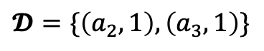
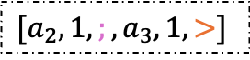
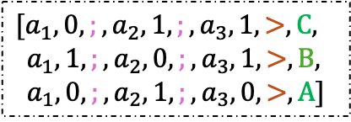
Our Framework
Given $\left|𝒜\right|=3, 𝒜=\{a_{1},a_{2},a_{3}\}$, generate all $M=2^{\left|𝒜\right|}$ hypotheses with binary labels
 | $$a_{1}$$ | $$a_{2}$$ | $$a_{3}$$
$$h_{1}$$ | 0 | 0 | 0
$$h_{2}$$ | 0 | 0 | 1
$$h_{3}$$ | 0 | 1 | 0
$$h_{4}$$ | 0 | 1 | 1
$$h_{5}$$ | 1 | 0 | 0
$$h_{6}$$ | 1 | 0 | 1
$$h_{7}$$ | 1 | 1 | 0
$$h_{8}$$ | 1 | 1 | 1
hypothesis class
Sample m=3 hypotheses
 | $$a_{1}$$ | $$a_{2}$$ | $$a_{3}$$
$$h_{4}$$ | 0 | 1 | 1
$$h_{6}$$ | 1 | 0 | 1
$$h_{3}$$ | 0 | 1 | 0
$$[a_{1},0,;,a_{2},1,;,a_{3},1,>,C,$$
$a_{1},1,;,a_{2},0,;,a_{3},1,>,B,$
$$a_{1},0, ;,a_{2},1,;,a_{3},0,>,A]$$
$$[a_{2},1,;,a_{3},1, >]$$
context query
$$𝓓=\{\left(a_{2},1\right),\left(a_{3},1\right)\}$$
hypothesis table
hypothesis prefix
dataset

Slide 30
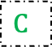
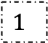

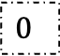
Our Framework
Given $\left|𝒜\right|=3, 𝒜=\{a_{1},a_{2},a_{3}\}$, generate all $M=2^{\left|𝒜\right|}$ hypotheses with binary labels
 | $$a_{1}$$ | $$a_{2}$$ | $$a_{3}$$
$$h_{1}$$ | 0 | 0 | 0
$$h_{2}$$ | 0 | 0 | 1
$$h_{3}$$ | 0 | 1 | 0
$$h_{4}$$ | 0 | 1 | 1
$$h_{5}$$ | 1 | 0 | 0
$$h_{6}$$ | 1 | 0 | 1
$$h_{7}$$ | 1 | 1 | 0
$$h_{8}$$ | 1 | 1 | 1
$$1$$
$$0$$
$$C$$
hypothesis class
Transformer
Sample m=3 hypotheses
 | $$a_{1}$$ | $$a_{2}$$ | $$a_{3}$$
$$h_{4}$$ | 0 | 1 | 1
$$h_{6}$$ | 1 | 0 | 1
$$h_{3}$$ | 0 | 1 | 0
$$[a_{1},0,;,a_{2},1,;,a_{3},1,>,C,$$
$a_{1},1,;,a_{2},0,;,a_{3},1,>,B,$
$a_{1},0, ;,a_{2},1,;,a_{3},0,>,A]$
$$[a_{2},1,;,a_{3},1, >]$$
context query
$$𝓓=\{\left(a_{2},1\right),\left(a_{3},1\right)\}$$
hypothesis table
hypothesis prefix
dataset

Slide 31
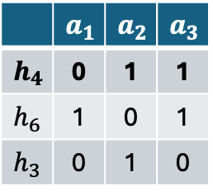
Training: i.i.d.
Given $\left|𝒜\right|=3, 𝒜=\{a_{1},a_{2},a_{3}\}$, generate all $M=2^{\left|𝒜\right|}$ hypotheses with binary labels
 | $$a_{1}$$ | $$a_{2}$$ | $$a_{3}$$
$$h_{1}$$ | 0 | 0 | 0
$$h_{2}$$ | 0 | 0 | 1
$$h_{3}$$ | 0 | 1 | 0
$$h_{4}$$ | 0 | 1 | 1
$$h_{5}$$ | 1 | 0 | 0
$$h_{6}$$ | 1 | 0 | 1
$$h_{7}$$ | 1 | 1 | 0
$$h_{8}$$ | 1 | 1 | 1
$$1$$
$$0$$
$$C$$
hypothesis class
Transformer
Sample m=3 hypotheses
 | $$a_{1}$$ | $$a_{2}$$ | $$a_{3}$$
$$h_{4}$$ | 0 | 1 | 1
$$h_{6}$$ | 1 | 0 | 1
$$h_{3}$$ | 0 | 1 | 0
$$[a_{1},0,;,a_{2},1,;,a_{3},1,>,C,$$
$a_{1},1,;,a_{2},0,;,a_{3},1,>,B,$
$a_{1},0, ;,a_{2},1,;,a_{3},0,>,A]$
$$[a_{2},1,;,a_{3},1, >]$$
context query
$$𝓓=\{\left(a_{2},1\right),\left(a_{3},1\right)\}$$
hypothesis table
hypothesis prefix
dataset
i.i.d. sampling

Slide 32
Training: Opt-T
Given $\left|𝒜\right|=3, 𝒜=\{a_{1},a_{2},a_{3}\}$, generate all $M=2^{\left|𝒜\right|}$ hypotheses with binary labels
 | $$a_{1}$$ | $$a_{2}$$ | $$a_{3}$$
$$h_{1}$$ | 0 | 0 | 0
$$h_{2}$$ | 0 | 0 | 1
$$h_{3}$$ | 0 | 1 | 0
$$h_{4}$$ | 0 | 1 | 1
$$h_{5}$$ | 1 | 0 | 0
$$h_{6}$$ | 1 | 0 | 1
$$h_{7}$$ | 1 | 1 | 0
$$h_{8}$$ | 1 | 1 | 1
$$1$$
$$0$$
$$C$$
hypothesis class
Transformer
Sample m=3 hypotheses
 | $$a_{1}$$ | $$a_{2}$$ | $$a_{3}$$
$$h_{4}$$ | 0 | 1 | 1
$$h_{6}$$ | 1 | 0 | 1
$$h_{3}$$ | 0 | 1 | 0
$$[a_{1},0,;,a_{2},1,;,a_{3},1,>,C,$$
$a_{1},1,;,a_{2},0,;,a_{3},1,>,B,$
$a_{1},0, ;,a_{2},1,;,a_{3},0,>,A]$
$$[a_{2},1,;,a_{3},1, >]$$
context query
$$𝓓=\{\left(a_{2},1\right),\left(a_{3},1\right)\}$$
hypothesis table
hypothesis prefix
dataset
Optimal Teaching Set:
The minimum set of samples to distinguish a hypothesis from the others

Slide 33
Comparison: existing vs ours

Slide 34
Experiments: Goal
Deliver a framework
Show this framework can support diverse studies on ICL and TF’s properties

Slide 35
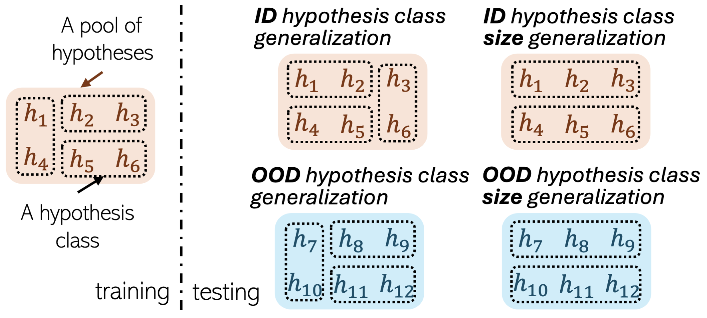
Experiments: 4 Types of Generalization

Slide 36
Experiments: 4 Types of Generalization

Slide 37
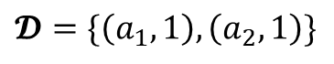
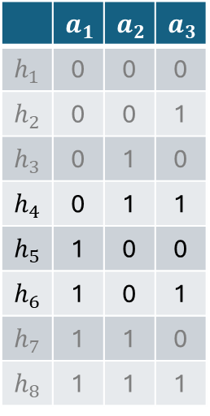
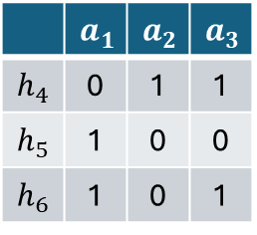
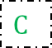
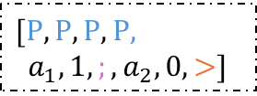
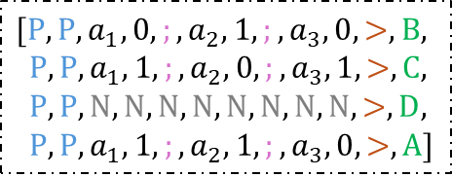
Experiments: 4 Types of Generalization
 | $$a_{1}$$ | $$a_{2}$$ | $$a_{3}$$
$$h_{1}$$ | 0 | 0 | 0
$$h_{2}$$ | 0 | 0 | 1
$$h_{3}$$ | 0 | 1 | 0
$$h_{4}$$ | 0 | 1 | 1
$$h_{5}$$ | 1 | 0 | 0
$$h_{6}$$ | 1 | 0 | 1
$$h_{7}$$ | 1 | 1 | 0
$$h_{8}$$ | 1 | 1 | 1
$$C$$
hypothesis class
Transformer
Sample m=3 hypotheses
 | $$a_{1}$$ | $$a_{2}$$ | $$a_{3}$$
$$h_{4}$$ | 0 | 1 | 1
$$h_{5}$$ | 1 | 0 | 0
$$h_{6}$$ | 1 | 0 | 1
$$[P,P,a_{1},0,;,a_{2},1,;,a_{3},0,>,B,$$
$P,P,a_{1},1,;,a_{2},0,;,a_{3},1,>,C,$
$P,P,N,N,N,N,N,N,N,N,>,D,$
$P,P,a_{1},1, ;,a_{2},1,;,a_{3},0,>,A]$
$[P,P,P,P$,
$a_{1},1,;,a_{2},0, >]$
context query
$$𝓓=\{\left(a_{1},1\right),\left(a_{2},1\right)\}$$
hypothesis table
hypothesis prefix
dataset

Slide 38
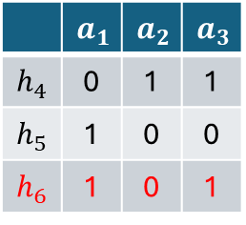
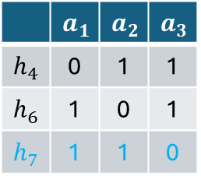
Experiments: 4 Types of Generalization
 | $$a_{1}$$ | $$a_{2}$$ | $$a_{3}$$
$$h_{1}$$ | 0 | 0 | 0
$$h_{2}$$ | 0 | 0 | 1
$$h_{3}$$ | 0 | 1 | 0
$$h_{4}$$ | 0 | 1 | 1
$$h_{5}$$ | 1 | 0 | 0
$$h_{6}$$ | 1 | 0 | 1
$$h_{7}$$ | 1 | 1 | 0
$$h_{8}$$ | 1 | 1 | 1
$$C$$
hypothesis class
Transformer
Sample m=3 hypotheses
 | $$a_{1}$$ | $$a_{2}$$ | $$a_{3}$$
$$h_{4}$$ | 0 | 1 | 1
$$h_{5}$$ | 1 | 0 | 0
$$h_{6}$$ | 1 | 0 | 1
$$[P,P,a_{1},0,;,a_{2},1,;,a_{3},0,>,B,$$
$P,P,a_{1},1,;,a_{2},0,;,a_{3},1,>,C,$
$P,P,N,N,N,N,N,N,N,N,>,D,$
$P,P,a_{1},1, ;,a_{2},1,;,a_{3},0,>,A]$
$[P,P,P,P$,
$a_{1},1,;,a_{2},0, >]$
context query
$$𝓓=\{\left(a_{1},1\right),\left(a_{2},1\right)\}$$
hypothesis table
hypothesis prefix
dataset
training
testing
 | $$a_{1}$$ | $$a_{2}$$ | $$a_{3}$$
$$h_{4}$$ | 0 | 1 | 1
$$h_{5}$$ | 1 | 0 | 0
$$h_{6}$$ | 1 | 0 | 1
 | $$a_{1}$$ | $$a_{2}$$ | $$a_{3}$$
$$h_{4}$$ | 0 | 1 | 1
$$h_{6}$$ | 1 | 0 | 1
$$h_{7}$$ | 1 | 1 | 0
ID hypothesis class generalization
(training and testing using different spaces)

Slide 39
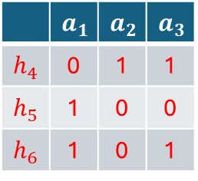
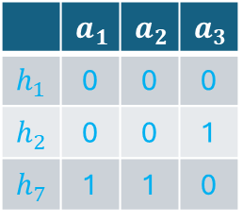
Experiments: 4 Types of Generalization
 | $$a_{1}$$ | $$a_{2}$$ | $$a_{3}$$
$$h_{1}$$ | 0 | 0 | 0
$$h_{2}$$ | 0 | 0 | 1
$$h_{3}$$ | 0 | 1 | 0
$$h_{4}$$ | 0 | 1 | 1
$$h_{5}$$ | 1 | 0 | 0
$$h_{6}$$ | 1 | 0 | 1
$$h_{7}$$ | 1 | 1 | 0
$$h_{8}$$ | 1 | 1 | 1
$$C$$
hypothesis class
Transformer
Sample m=3 hypotheses
 | $$a_{1}$$ | $$a_{2}$$ | $$a_{3}$$
$$h_{4}$$ | 0 | 1 | 1
$$h_{5}$$ | 1 | 0 | 0
$$h_{6}$$ | 1 | 0 | 1
$$[P,P,a_{1},0,;,a_{2},1,;,a_{3},0,>,B,$$
$P,P,a_{1},1,;,a_{2},0,;,a_{3},1,>,C,$
$P,P,N,N,N,N,N,N,N,N,>,D,$
$P,P,a_{1},1, ;,a_{2},1,;,a_{3},0,>,A]$
$[P,P,P,P$,
$a_{1},1,;,a_{2},0, >]$
context query
$$𝓓=\{\left(a_{1},1\right),\left(a_{2},1\right)\}$$
hypothesis table
hypothesis prefix
dataset
training
testing
 | $$a_{1}$$ | $$a_{2}$$ | $$a_{3}$$
$$h_{4}$$ | 0 | 1 | 1
$$h_{5}$$ | 1 | 0 | 0
$$h_{6}$$ | 1 | 0 | 1
 | $$a_{1}$$ | $$a_{2}$$ | $$a_{3}$$
$$h_{1}$$ | 0 | 0 | 0
$$h_{2}$$ | 0 | 0 | 1
$$h_{7}$$ | 1 | 1 | 0
OOD hypothesis class generalization
(training and testing using non-overlapping hypotheses)

Slide 40




Experiments: 4 Types of Generalization
 | $$a_{1}$$ | $$a_{2}$$ | $$a_{3}$$
$$h_{1}$$ | 0 | 0 | 0
$$h_{2}$$ | 0 | 0 | 1
$$h_{3}$$ | 0 | 1 | 0
$$h_{4}$$ | 0 | 1 | 1
$$h_{5}$$ | 1 | 0 | 0
$$h_{6}$$ | 1 | 0 | 1
$$h_{7}$$ | 1 | 1 | 0
$$h_{8}$$ | 1 | 1 | 1
$$C$$
hypothesis class
Transformer
Sample m=3 hypotheses
 | $$a_{1}$$ | $$a_{2}$$ | $$a_{3}$$
$$h_{4}$$ | 0 | 1 | 1
$$h_{5}$$ | 1 | 0 | 0
$$h_{6}$$ | 1 | 0 | 1
$$[P,P,a_{1},0,;,a_{2},1,;,a_{3},0,>,B,$$
$P,P,a_{1},1,;,a_{2},0,;,a_{3},1,>,C,$
$P,P,N,N,N,N,N,N,N,N,>,D,$
$P,P,a_{1},1, ;,a_{2},1,;,a_{3},0,>,A]$
$[P,P,P,P$,
$a_{1},1,;,a_{2},0, >]$
context query
$$𝓓=\{\left(a_{1},1\right),\left(a_{2},1\right)\}$$
hypothesis table
hypothesis prefix
dataset
training
testing
 | $$a_{1}$$ | $$a_{2}$$ | $$a_{3}$$
$$h_{4}$$ | 0 | 1 | 1
$$h_{5}$$ | 1 | 0 | 0
 | $$a_{1}$$ | $$a_{2}$$ | $$a_{3}$$
$$h_{4}$$ | 0 | 1 | 1
$$h_{5}$$ | 1 | 0 | 0
$$h_{6}$$ | 1 | 0 | 1
 | $$a_{1}$$ | $$a_{2}$$ | $$a_{3}$$
$$h_{4}$$ | 0 | 1 | 1
 | $$a_{1}$$ | $$a_{2}$$ | $$a_{3}$$
$$h_{4}$$ | 0 | 1 | 1
$$h_{5}$$ | 1 | 0 | 0
$$h_{6}$$ | 1 | 0 | 1
$$h_{7}$$ | 1 | 1 | 0
Length Generalization
(training and testing using space with different length)

Slide 41

Experiment 1: 4 Types of Generalization

Slide 42

Experiment 1: 4 Types of Generalization

Slide 43


Experiment 1: 4 Types of Generalization

Slide 44

Experiment 2: Compare Different Models

Slide 45


Experiment 2: Compare Different Models

Slide 46







Experiment 3: Num of Training Tables
 | $$a_{1}$$ | $$a_{2}$$ | $$a_{3}$$
$$h_{1}$$ | 0 | 0 | 0
$$h_{2}$$ | 0 | 0 | 1
$$h_{3}$$ | 0 | 1 | 0
$$h_{4}$$ | 0 | 1 | 1
$$h_{5}$$ | 1 | 0 | 0
$$h_{6}$$ | 1 | 0 | 1
$$h_{7}$$ | 1 | 1 | 0
$$h_{8}$$ | 1 | 1 | 1
$$1$$
$$0$$
$$C$$
hypothesis class
Transformer
Sample m=3 hypotheses
 | $$a_{1}$$ | $$a_{2}$$ | $$a_{3}$$
$$h_{4}$$ | 0 | 1 | 1
$$h_{5}$$ | 1 | 0 | 0
$$h_{3}$$ | 0 | 1 | 0
$$[a_{1},0,;,a_{2},1,;,a_{3},1,>,C,$$
$a_{1},1,;,a_{2},0,;,a_{3},1,>,B,$
$a_{1},0, ;,a_{2},1,;,a_{3},0,>,A]$
$$[a_{2},1,;,a_{3},1, >]$$
context query
hypothesis table
$$𝓓=\{\left(a_{2},1\right),\left(a_{3},1\right)\}$$
hypothesis prefix
dataset
How many training classes are needed to achieve good generalization performance?

Slide 47


Experiment 3: Num of Training Tables

Slide 48
Experiment 4: Sample Imbalance
 | $$a_{1}$$ | $$a_{2}$$ | $$a_{3}$$
$$h_{1}$$ | 0 | 0 | 0
$$h_{2}$$ | 0 | 0 | 1
$$h_{3}$$ | 0 | 1 | 0
$$h_{4}$$ | 0 | 1 | 1
$$h_{5}$$ | 1 | 0 | 0
$$h_{6}$$ | 1 | 0 | 1
$$h_{7}$$ | 1 | 1 | 0
$$h_{8}$$ | 1 | 1 | 1
$$C$$
hypothesis class
Transformer
Sample m=3 hypotheses
 | $$a_{1}$$ | $$a_{2}$$ | $$a_{3}$$
$$h_{4}$$ | 0 | 1 | 1
$$h_{5}$$ | 1 | 0 | 0
$$h_{6}$$ | 1 | 0 | 1
$$[P,P,a_{1},0,;,a_{2},1,;,a_{3},0,>,B,$$
$P,P,a_{1},1,;,a_{2},0,;,a_{3},1,>,C,$
$P,P,N,N,N,N,N,N,N,N,>,D,$
$P,P,a_{1},1, ;,a_{2},1,;,a_{3},0,>,A]$
$[P,P,P,P$,
$a_{1},1,;,a_{2},0, >]$
context query
$$𝓓=\{\left(a_{1},1\right),\left(a_{2},1\right)\}$$
hypothesis table
hypothesis prefix
dataset
What if these in-context samples are not i.i.d. sampled during training?

Slide 49



Experiment 4: Sample Imbalance

Slide 50






Experiment 5: Compare with Normal ICL
 | $$a_{1}$$ | $$a_{2}$$ | $$a_{3}$$
$$h_{1}$$ | 0 | 0 | 0
$$h_{2}$$ | 0 | 0 | 1
$$h_{3}$$ | 0 | 1 | 0
$$h_{4}$$ | 0 | 1 | 1
$$h_{5}$$ | 1 | 0 | 0
$$h_{6}$$ | 1 | 0 | 1
$$h_{7}$$ | 1 | 1 | 0
$$h_{8}$$ | 1 | 1 | 1
$$1$$
$$0$$
$$C$$
hypothesis class
Transformer
Sample m=3 hypotheses
 | $$a_{1}$$ | $$a_{2}$$ | $$a_{3}$$
$$h_{4}$$ | 0 | 1 | 1
$$h_{5}$$ | 1 | 0 | 0
$$h_{3}$$ | 0 | 1 | 0
$$[a_{1},0,;,a_{2},1,;,a_{3},1,>,C,$$
$a_{1},1,;,a_{2},0,;,a_{3},1,>,B,$
$a_{1},0, ;,a_{2},1,;,a_{3},0,>,A]$
$$[a_{2},1,;,a_{3},0, >]$$
context query
hypothesis table
hypothesis prefix
$$𝓓=\{\left(a_{2},1\right),\left(a_{3},1\right)\}$$
dataset
What if there is no prefix available, i.e., normal ICL?
To compare with ICL,
we evaluate the accuracy on y

Slide 51


Experiment 5: Compare with Normal ICL -- ID hypothesis class generalization

Slide 52


Experiment 6: Diversity on Pretraining Hypotheses
 | $$a_{1}$$ | $$a_{2}$$ | $$a_{3}$$
$$h_{1}$$ | 0 | 0 | 0
$$h_{8}$$ | 1 | 1 | 1
$$h_{3}$$ | 0 | 1 | 0
$$h_{4}$$ | 0 | 1 | 1
$$h_{2}$$ | 0 | 0 | 1
$$h_{6}$$ | 1 | 0 | 1
$$h_{7}$$ | 1 | 1 | 0
$$h_{5}$$ | 1 | 0 | 0
$$1$$
$$0$$
$$C$$
testing
hypothesis class
Transformer
Sample m=3 hypotheses
 | $$a_{1}$$ | $$a_{2}$$ | $$a_{3}$$
$$h_{4}$$ | 0 | 1 | 1
$$h_{5}$$ | 1 | 0 | 0
$$h_{3}$$ | 0 | 1 | 0
$$[a_{1},0,;,a_{2},1,;,a_{3},1,>,C,$$
$a_{1},1,;,a_{2},0,;,a_{3},1,>,B,$
$a_{1},0, ;,a_{2},1,;,a_{3},0,>,A]$
$$[a_{2},1,;,a_{3},1, >]$$
context query
hypothesis table
hypothesis prefix
$$𝓓=\{\left(a_{2},1\right),\left(a_{3},1\right)\}$$
dataset
training
What if there only partial of the hypotheses are used for pretraining?
we evaluate the accuracy on y

Slide 53


Experiment 6: Diversity on Pretraining Hypotheses

Slide 54
Thank you for your attend!

Slide 55

Background+: Similar Work
Task Descriptors Help Transformers Learn Linear Models In-Context

Slide 56

Background+: Similar Work
Task Descriptors Help Transformers Learn Linear Models In-Context
On Task Description of In-context Learning: A Study from Information Perspective

Slide 57
Background+: Similar Work
Task Descriptors Help Transformers Learn Linear Models In-Context
On Task Description of In-context Learning: A Study from Information Perspective
Ours:
explicit hypothesis class
these two works:
Implicit(X) information

